Slide 1

Public class ProgrammingClub{
Club ProgrammingClub = new Club(“Tuesday Morning”, “G208”);
if(you.enjoy(“coding”) || you.wantToLearn(“coding”){
you.joinClub(ProgrammingClub);
}
Find out more at DHSProgramming.com

Slide 2
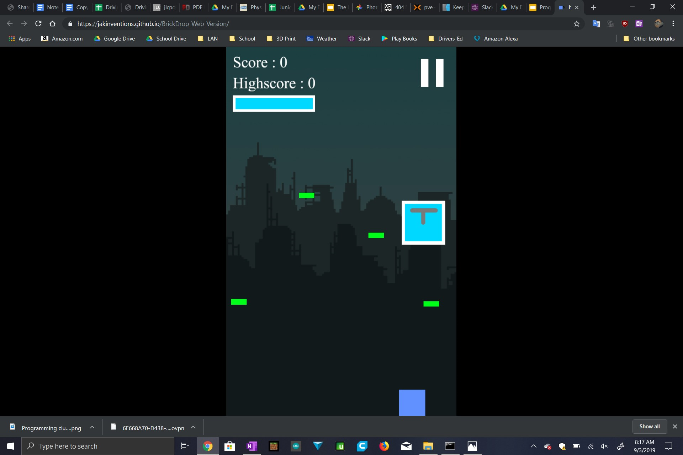

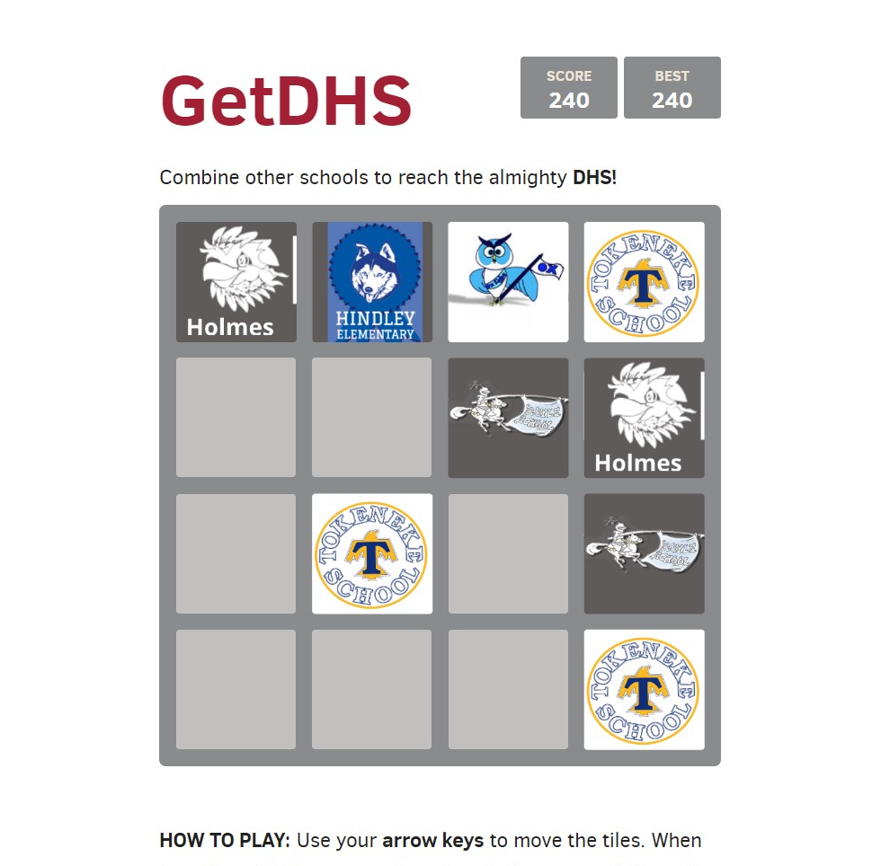
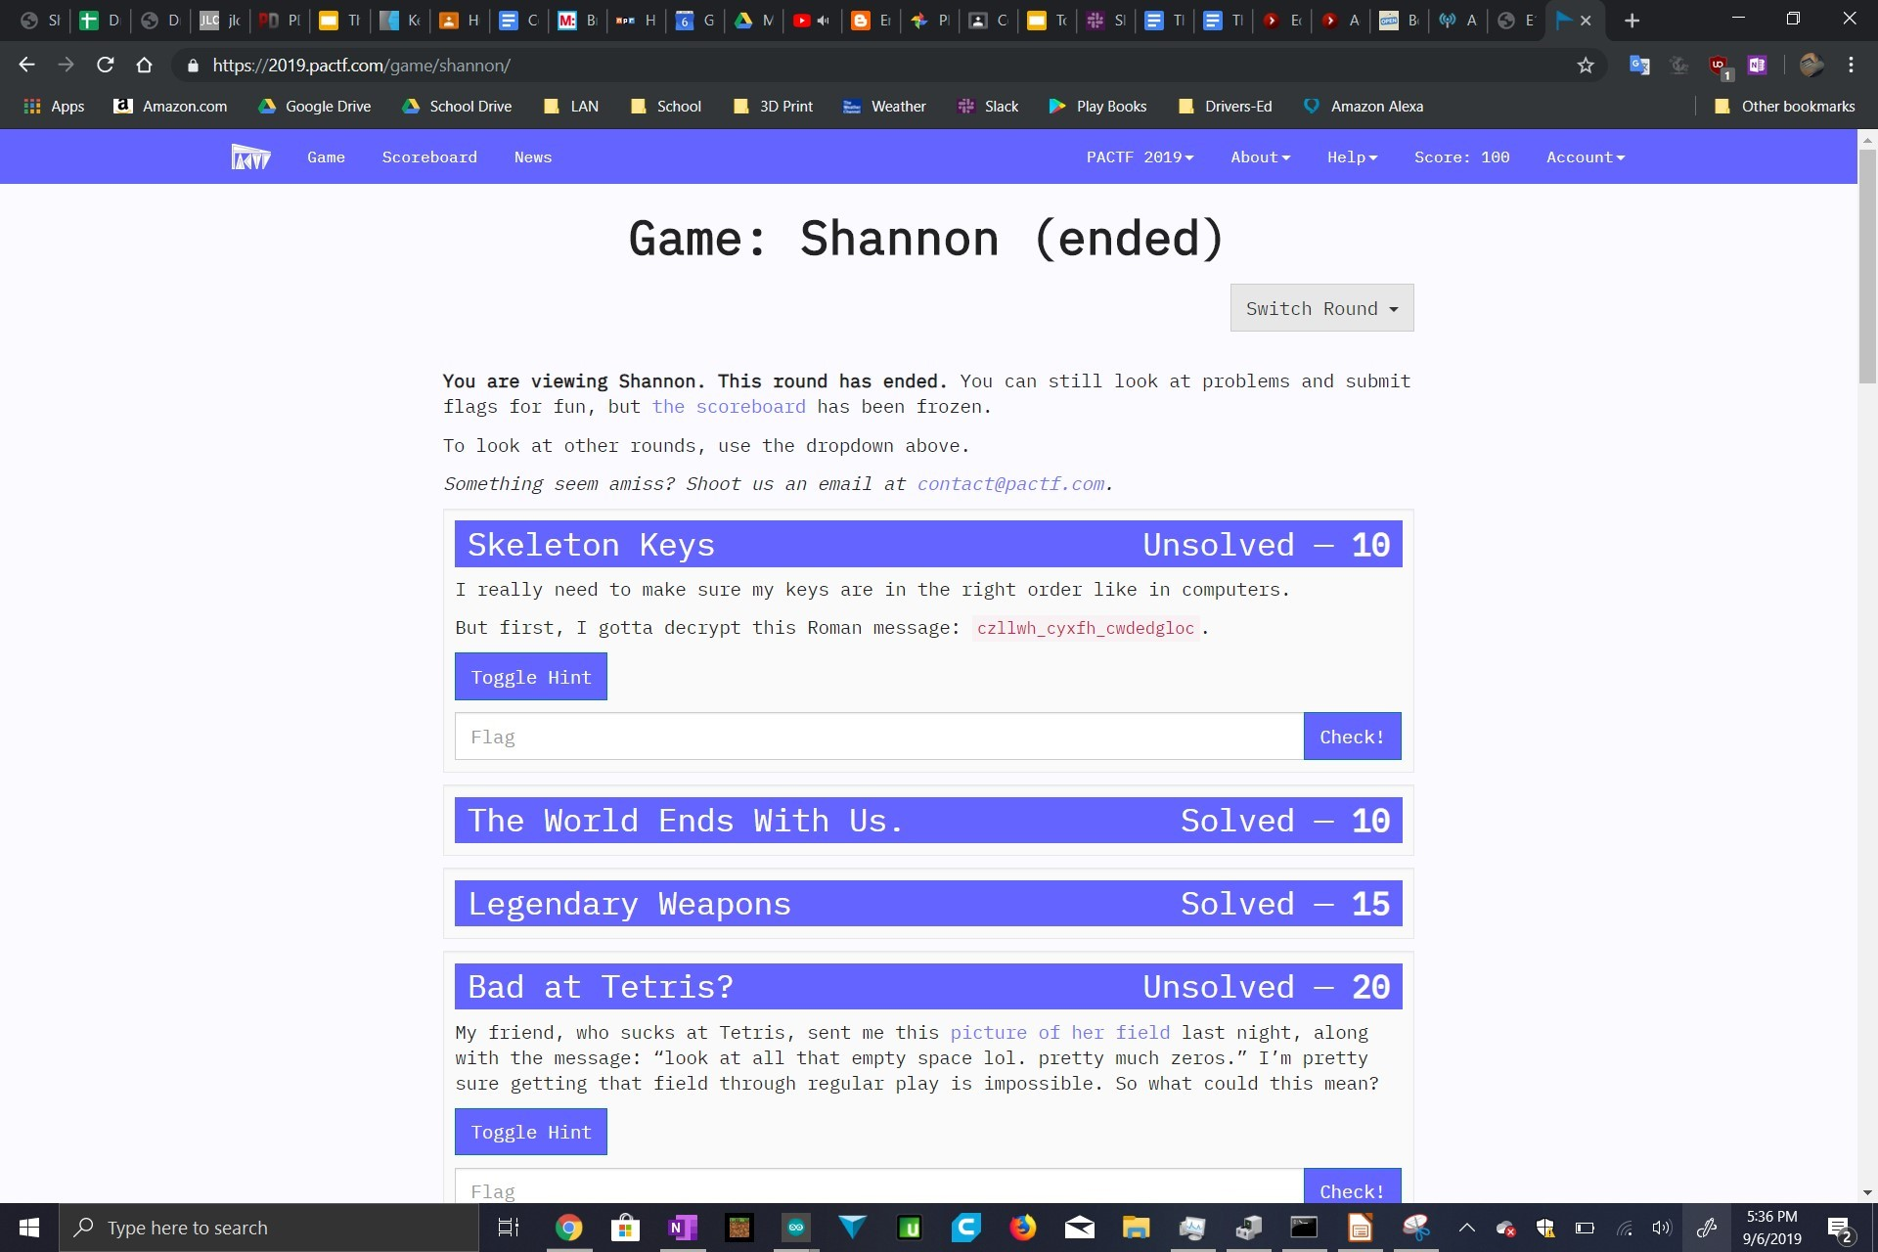
android.firstmet.com
Projects:
Activities:
Brickdrop
(brickdrop.jakinventions.com)
Our members have taught introductions to Python, Arduino, Game Design, and more for the hour of Code
CTF
Fun hacking/coding puzzles online! Win Prizes!
Some CTF picture
GetDHS
(getdhs.tgctech.org)

